Slide 1


<Name>
<Date>

Slide 2

Outline
Executive Summary
Introduction
Methodology
Results
Conclusion
Appendix

Slide 3
Executive Summary
In this project has as its objective to predict whether the SpaceX Falcon 9 first stage will land successfully and the cost of the launch. This will be presented by the use of diverse machine learning classification algorithms. As methodology followed will include Data collection, Data Wrangling and Preprocessing, Exploratory Data Analysis, Data Visualization, and finally, Machine Learning Prediction. The outcomes of our analysis show a correlation between some features of rocket launches and the success or failure of launches. At the end, we've learned that the decision Tree may be the best machine-learning algorithm to for this problem.

Slide 4
Introduction
This project has as its objective to predict whether the SpaceX Falcon 9 first stage will land successfully. SpaceX is looking for cost reduction through the reuse of the first stage of the rocket launch for other missions, from 165 million to 62 million. With the data provided and using Data Science methodologies the objective is to demonstrate if the launch will be the first stage of the rocket land successfully.

Slide 5

Section 1

Slide 6
Methodology
Executive Summary
Data collection methodology: Data is being collected by requesting data from the SpaceX API and web scraping launch data from a Wikipedia page.
Data wrangling: The data wrangling is performed to transform and clean the data by Python's pandas library.
EDA: Is executed by Python's matplotlib and saborn libraries, using SQL queries to get answers to the hypothesis.
For interactive visual analytics by Folium and Plotly Dash.
Finally, for machine learning, we use trained and evaluated method as Logistic Regression, Support Vector Machines, K-NN, and Decision tree Classifiers to select the best one.

Slide 7
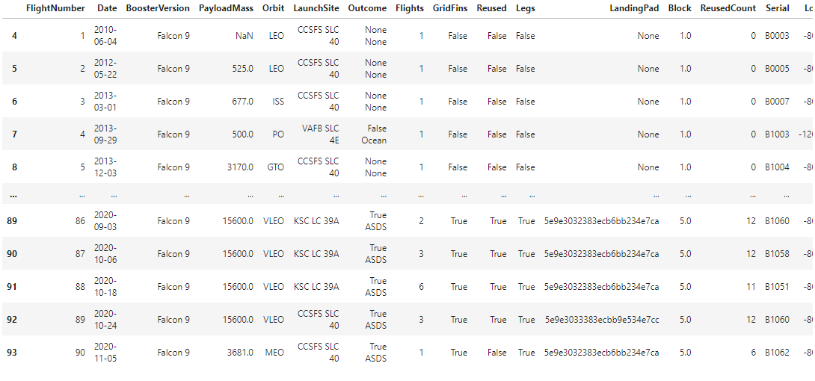
Data Data Collection – SpaceX API
Request and parse the SpaceX launch data using the GET Request
Normalize JSON response into a dataframe
Extract only useful columns using auxiliary functions
Create new pandas dataframe from the dictionary
Filter dataframe to only include Falcon 9 launches
. Handle missing values
Export CSV
GitHub URL: Data Collection API

Slide 8
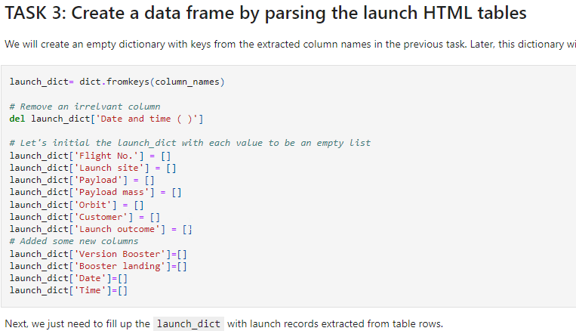
Data Collection - Scraping
Request rocket launch data from its Wikipedia page
Extract all column/variable names from the HTML table header
Create a data frame by parsing the launch HTML tables
Export to CSV file
GitHub URL: Data Collection Scraping

Slide 9
Data Wrangling
Describe how data were processed
You need to present your data wrangling process using key phrases and flowcharts
Add the GitHub URL of your completed data wrangling related notebooks, as an external reference and peer-review purpose

Slide 10
Data Collection - Wrangling
Calculate the number of launches on each site
Calculate the number and occurrence of each orbit
Calculate the number and occurence of mission outcome per orbit type
Create a landing outcome label from Outcome column using
Export to CSV
GitHub URL: Data Collection Wrangling

Slide 11
EDA with Data Visualization
GitHub URL: Data Viz
Scatter plots: Scatter plots were used to represent the relationship between two variables. Different sets of features were compared such as Flight Number vs. Launch Site, Payload vs. Launch Site, Flight
Number vs. Orbit Type and Payload vs. Orbit Type.
Bar chart: Bar charts were used makes it easy to compare values between multiple groups at a glance. The x-axis represents a category and the y-axis represents a discrete value. Bar charts were used to compare the Success Rate for different Orbit Types
Line chart: Line charts are useful for showing data trends over time. A line chart was used to show Success Rate over a certain number of Years.

Slide 12
EDA with SQL
GitHub URL: Data EDA
SQL queries performed on the dataset is listed below:
Displaying the names of the unique launch sites in the space mission --- Displaying 5 records where launch sites begin with the string 'CCA' --- Displaying the total payload mass carried by boosters launched by NASA (CRS) --- Displaying average payload mass carried by booster version F9 v1.1,
Listing the date when the first successful landing outcome in ground pad was achieved --- Listing the names of the boosters which have success in drone ship and have payload mass greater than 4000 but less than 6000 --- Listing the total number of successful and failure mission outcomes ---
Listing the names of the booster versions which have carried the maximum payload mass
Listing the failed landing outcomes in drone ship, their booster versions, and launch site names for in year 2015
Ranking the count of landing outcomes between the date 2010-06-04 and 2017-03-20, in descending order.

Slide 13
Build an Interactive Map with Folium
GitHub URL: Data MAP
Objects were created and added to a Folium map. Marker objects were used to show all launch sites on a map as well as the successful/failed launches for each site on the map. Line objects were used to calculate the distances between a launch site to its proximities
By adding these objects, following geographical patterns about launch sites are found:
Are launch sites in close proximity to railways? Yes
Are launch sites in close proximity to highways? Yes
Are launch sites in close proximity to coastline? Yes
Do launch sites keep certain distance away from cities? Yes

Slide 14
Build a Dashboard with Plotly Dash
GitHub URL: Data Plot
The dashboard application contains two charts:
• A pie chart that shows the successful launch by each site. This chart is useful as you can visualize the distribution of landing outcomes across all launch sites or show the success rate of launches on individual sites.
• A scatter chart that shows the relationship between landing outcomes an the payload mass of different boosters. The dashboard takes two inputs, namely the site(s) and payload mass. This chart is useful as you can visualize how different variables affect the landing outcomes.

Slide 15
Predictive Analysis (Classification)
GitHub URL: Data Analysis
Create column for “Class”
Standardizing the data
Split ito training and test set
Find best Hyperparameter for SVM, Decision Trees, K-Nearest
Neighbours and Logistic Regression.
Use test data to evaluate models based on their accuracy
scores and confusion matrix
15

Slide 16
Results
• The results of the exploratory data analysis revealed that the success rate of the Falcon 9 landings was 66.66%
• The predictive analysis results showed that the Decision Tree algorithm was the best classification method with an accuracy of 94%

Slide 17

Section 2

Slide 18
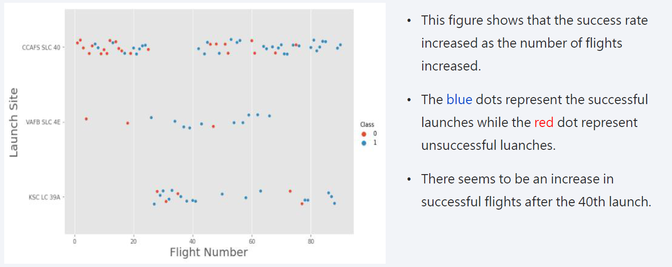
Flight Number vs. Launch Site

Slide 19
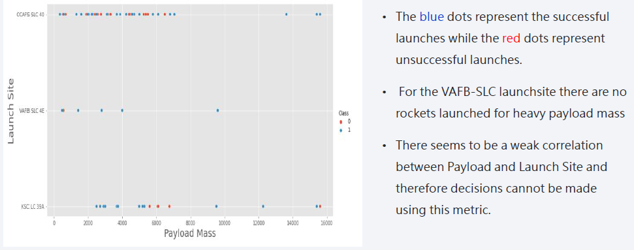
Payload vs. Launch Site

Slide 20
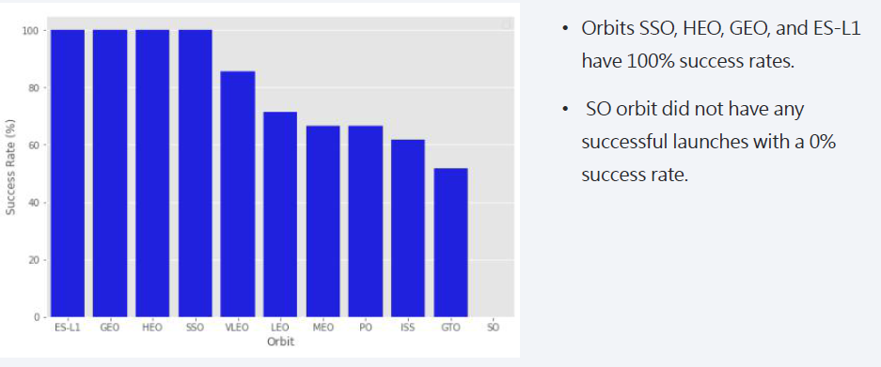
Success Rate vs. Orbit Type

Slide 21
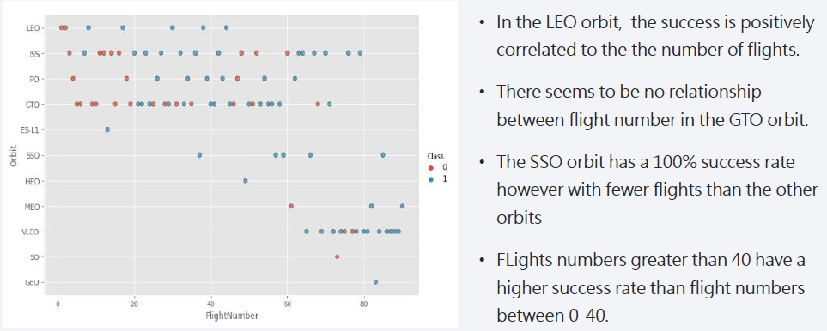
Flight Number vs. Orbit Type

Slide 22
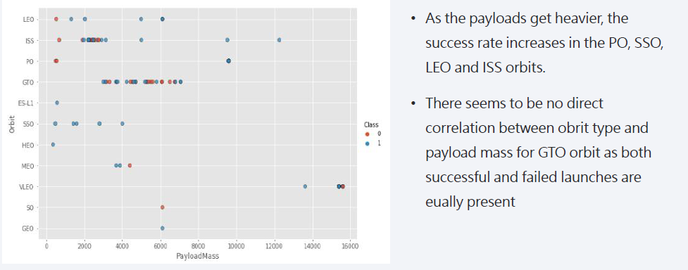
Payload vs. Orbit Type

Slide 23
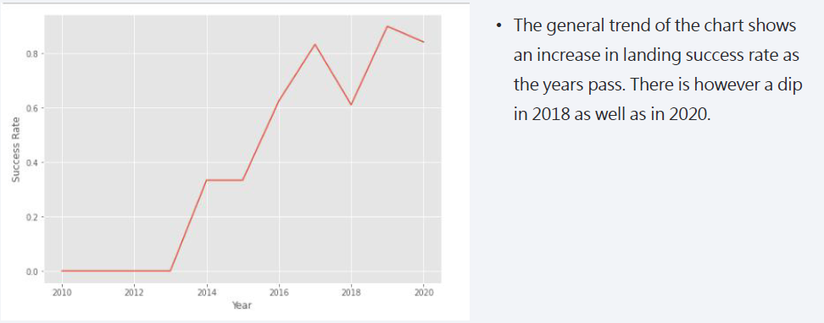
Launch Success Yearly Trend

Slide 24
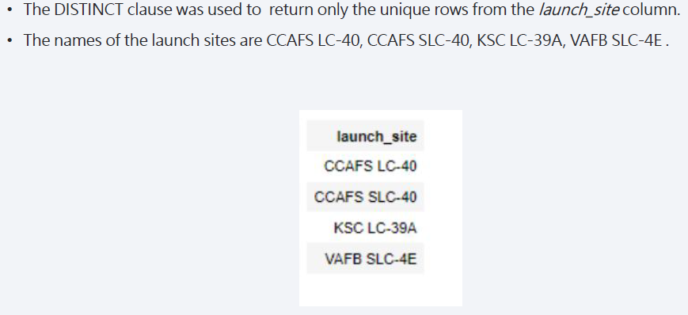
All Launch Site Names

Slide 25
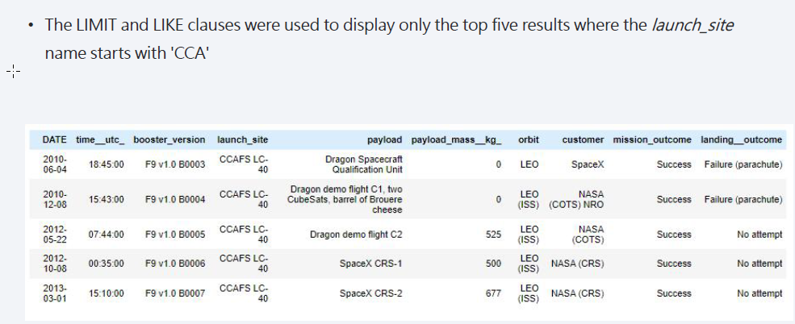
Launch Site Names Begin with 'CCA'

Slide 26
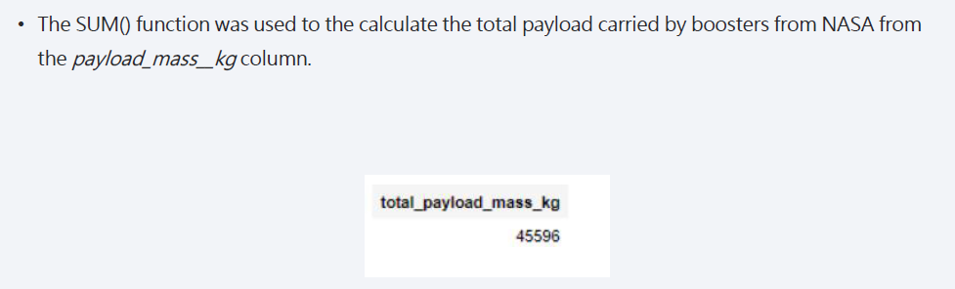
Total Payload Mass

Slide 27
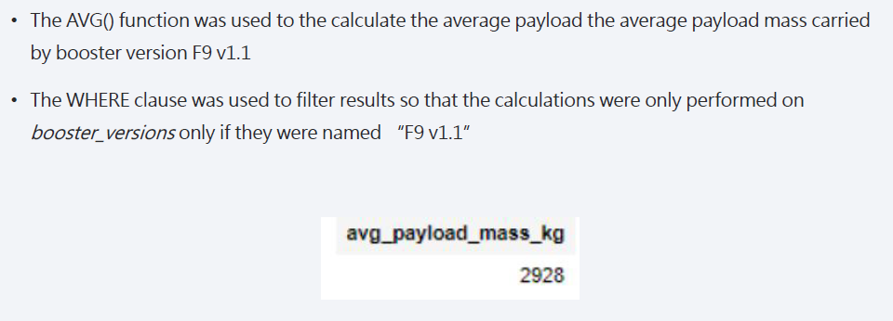
Average Payload Mass by F9 v1.1

Slide 28
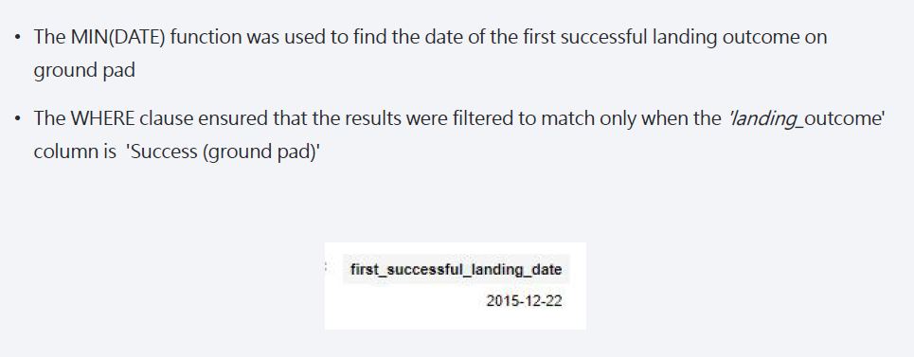
First Successful Ground Landing Date

Slide 29
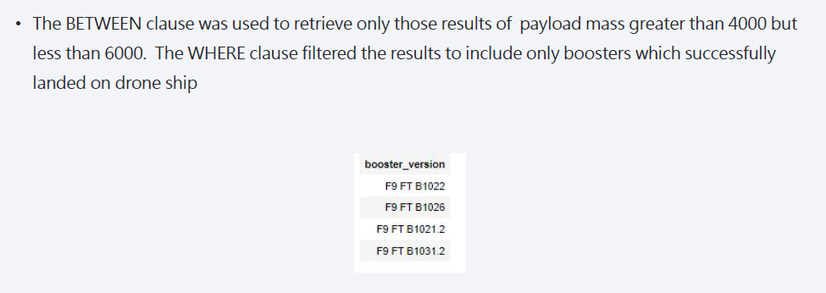
Successful Drone Ship Landing with Payload between 4000 and 6000

Slide 30
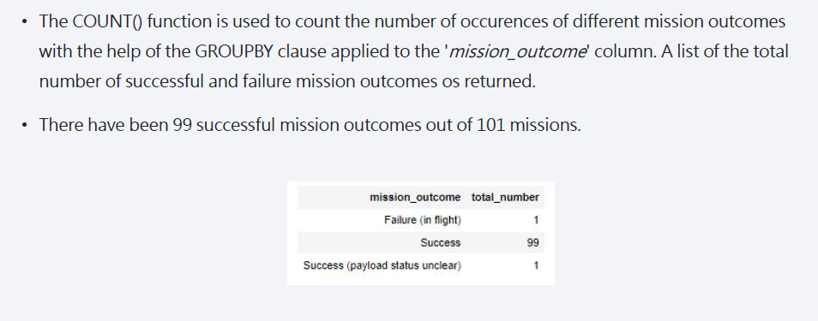
Total Number of Successful and Failure Mission Outcomes

Slide 31
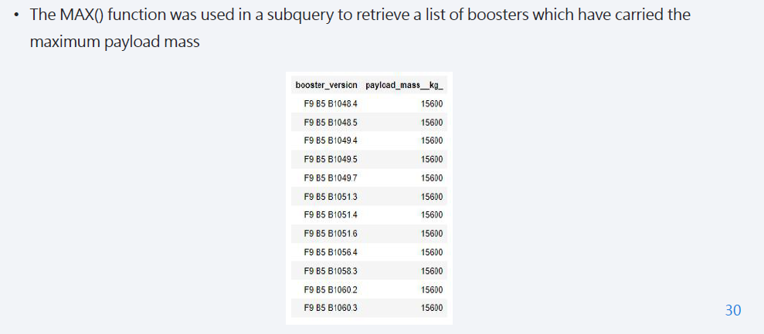
Boosters Carried Maximum Payload

Slide 32
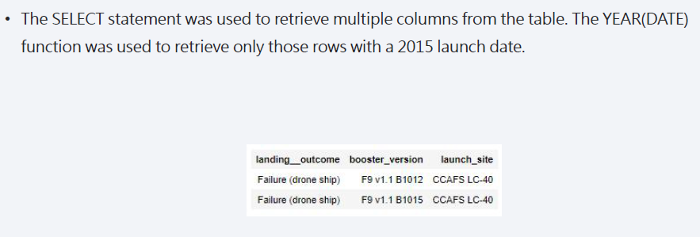
2015 Launch Records

Slide 33
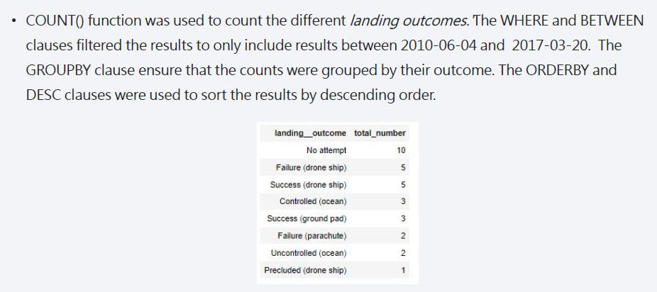
Rank Landing Outcomes Between 2010-06-04 and 2017-03-20

Slide 34

Section 3

Slide 35
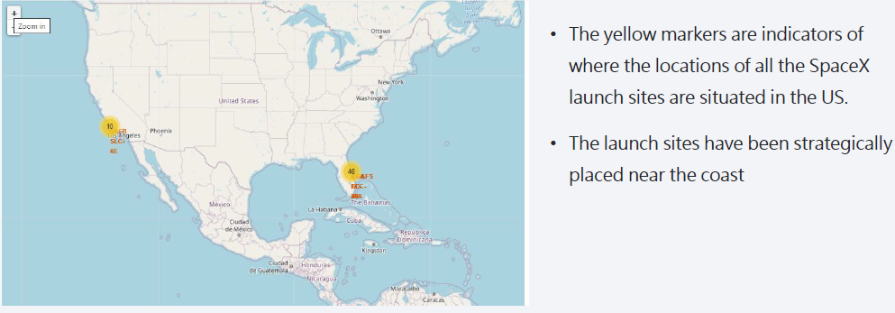
<Folium Map Screenshot 1>

Slide 36
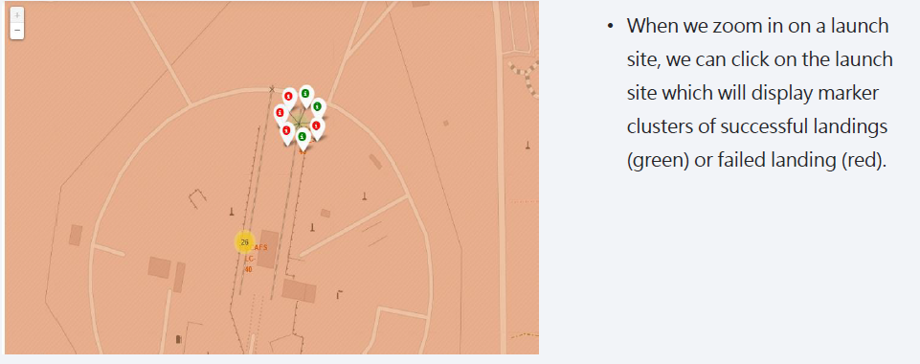
<Folium Map Screenshot 2>

Slide 37
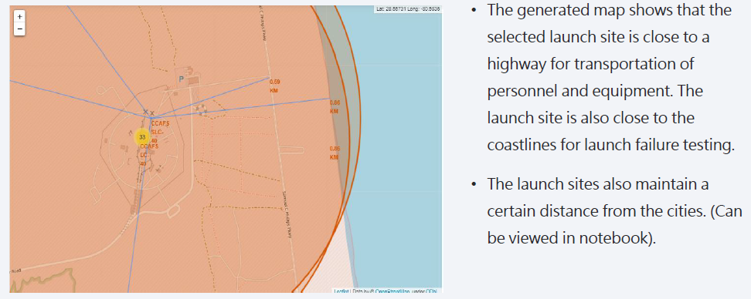
<Folium Map Screenshot 3>

Slide 38

Section 4

Slide 39
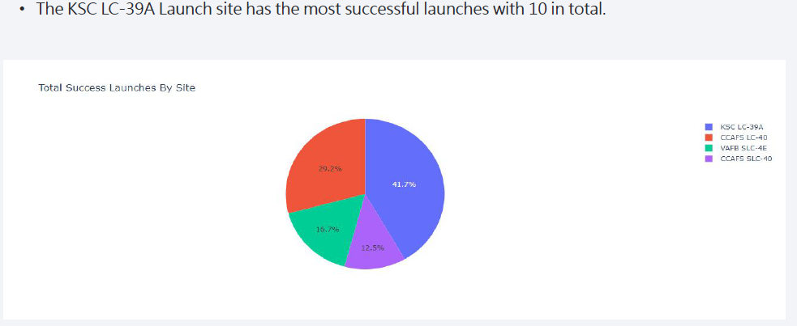
<Dashboard Screenshot 1>

Slide 40
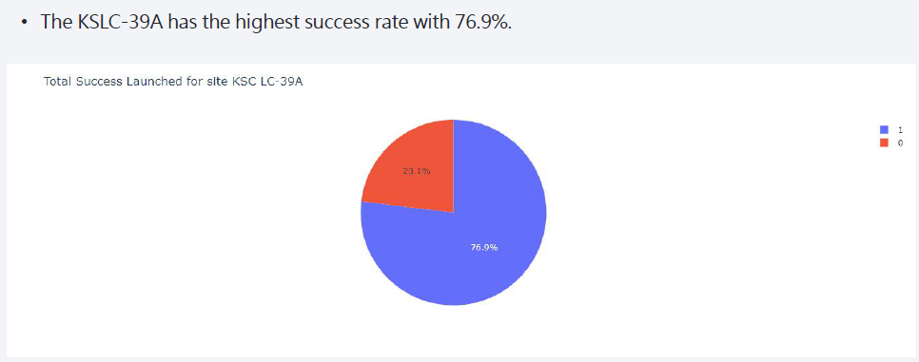
<Dashboard Screenshot 2>

Slide 41
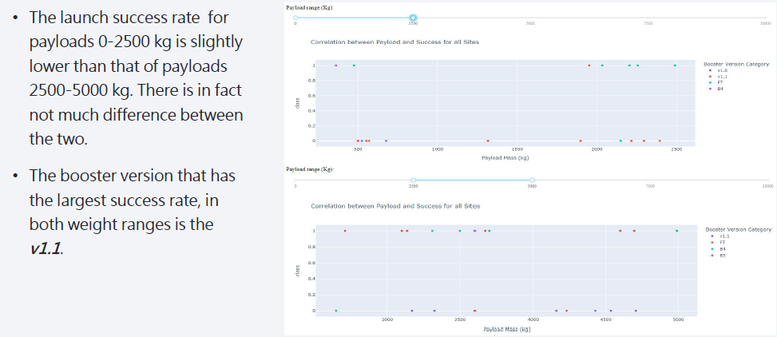
<Dashboard Screenshot 3>

Slide 42

Section 5

Slide 43
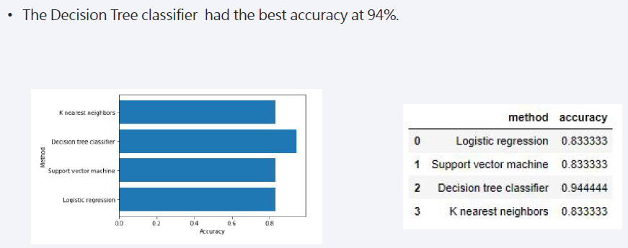
Classification Accuracy

Slide 44
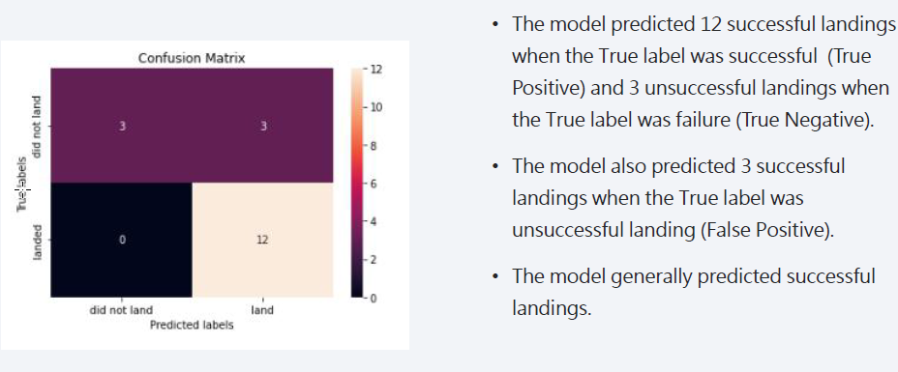
Confusion Matrix

Slide 45
Conclusions
After the analysis, we can conclude a positive correlation between the number of flights and the success rate in the time. Some orbits have a higher rate of success like SSO, HEO, GEO, and ES-L1 where launches were the most successful. This is because the payloads generally proved to be more successful on lower payloads. Finally the best model to predict the outcomes is Decision Tree due the 94% of accuracy.

Slide 46
Appendix
Coursera Project Link: https://www.coursera.org/learn/applied-data-sciencecapstone/home/welcome
GitHub Repository: https://github.com/withouttheh/IBM-Data-Science-Capstone-Project

Slide 47


